Slide 1

Rutgers University for Faculty Advancement and Institutional
Re-imagination
RU FAIR ADVANCE
NSF grant no. HRD-0810978
Institutional Site Visit
February 3rd and 4th, 2011
SciWomen: Join in the Discovery
Any opinions, findings, and conclusions or recommendations expressed in this material are those of the author(s) and do not necessarily reflect the views of the National Science Foundation.

Slide 2
Overview of Site Visit Presentation
Joan W. Bennett PI
Doreen Valentine Director
Patricia Roos Co-PI
Doreen Valentine Director
Natalie Batmanian Director
Helen Buettner Co-PI
Rutgers University and the Office for the Promotion of Women in SEM
Architecture of RU FAIR ADVANCE
Research: From Toolkit Indicators to Mixed Methods Approaches
Recruitment and Retention
Leadership and Professional Development
RU FAIR Professors and Concluding Thoughts

Slide 3
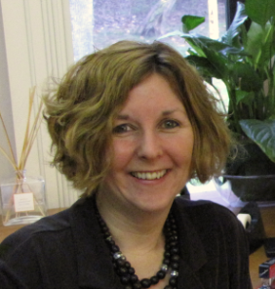
The Architecture of RU FAIR ADVANCE
Doreen Valentine, PhD
Director of RU FAIR ADVANCE &
Assistant Director in the Office for the Promotion of Women in Science, Engineering, and Mathematics

Slide 4
Overarching Goal of NSF ADVANCE
“The goal of the ADVANCE program is to develop systemic approaches to increase the representation and advancement of women in academic science, technology, engineering and mathematics (STEM) careers, thereby contributing to the development of a more diverse science and engineering workforce.”
NSF Solicitation 09-504

Slide 5
ADVANCE is a Paradigm Shift
Major shift in intervention philosophy from
the individual to the system
Transform the institution to facilitate the full participation and advancement of women in SEM
Focus analysis and intervention on the institution in a process of ongoing institutional change

Slide 6
Institutional Transformation at Rutgers
2003
2004
2005
2006
2007
2008
2009
2010
2011
Female SEM Faculty:
19.5%
Female SEM Faculty:
24.3%
Faculty Diversity Initiative
Transformation of Undergraduate Education
RU FAIR ADVANCE
Office on Institutional Diversity and Equity established
New Faculty Development Fund announced
Reaffirming Action:
Designs for Diversity in Higher Education
Ford Foundation grant (IWL)
President’s Council on Institutional Diversity & Equity established
Office for the Promotion of Women in SEM established
SciWomen joins IWL

Slide 7
Institutional Transformation:
A Top-down and Bottom-up Ecosystem
University Admin
RU FAIR
ADVANCE
Amplifies administrative & grassroots efforts
Empowers faculty
Builds partnerships & community
Engages stakeholders
Provides resources and tools
  Provides vision and commitment
  Creates fertile ground
  Removes barriers
  Implements policies
  Celebrates success
Administration
Schools& Depts
  Enable success of broader vision
  Plant seeds of action
  Enact solutions
  Engage community
Grassroots
IWL
OIRAP
OIDE
RU
FAIR
Collaborations
Faculty

Slide 8
RU FAIR ADVANCE & University Mission
INCREASE
INCREASE
RECRUIT
MATCH
CREATE
the NUMBER of WOMEN in SEM disciplines, particularly women of color
the gender and racial DIVERSITY of UNIVERSITY LEADERS
for EXCELLENCE as a leading-edge research university
FACULTY DIVERSITY with Rutgers’ achievement in student diversity
a high-skill, innovation-driven WORKFORCE for the 21st CENTURY
…by changing Rutgers’ institutional culture and practices

Slide 9
Broad Impacts of RU FAIR ADVANCE Initiatives
INCREASE
INCREASE
INCREASE
RECRUITMENT of female and under-represented faculty
the VISIBILITY of female Rutgers SEM faculty
FACULTY SATISFACTION through collaborative projects and opportunities
REDUCE
ATTRITION of female and under-represented faculty
INCREASE
the NUMBER OF WOMEN IN RANK and in
leadership positions
academic administration
areas of scholarly leadership

Slide 10
Our Targeted Strategy
Provide resources and support for engagement and success in science
Contribute to the development of visionary leaders
Serve as a national model for the advancement of women in science within higher education
Increase visibility and celebrate the success of distinguished women
Make the university a more family-friendly institution
Institutional Transformation

Slide 11
RU FAIR ADVANCE
Proposed Key Initiatives
Recruitment & Retention
Five initiatives targeted in our original NSF ADVANCE proposal
Key areas fundamental to institutional transformation
Communications
Networking & Liaisons
Visibility
Family

Slide 12
Evaluating the Original Key Initiatives
Recruitment & Retention
RU InSTRIDE model
President’s Council on Institutional Diversity and Equity emerged as the InSTRIDE body
Communications
Bridge three campuses through RU FAIR Professorships
Each event or program we support or lead impacts communications across diverse communities
Networking & Liaisons
Specifically with IWL and WGS
Refers to networking among faculty, administration and industry
Visibility
Highlight accomplishments of women in science
From awards, to web-based MyStory profiles, to lectures, RU FAIR has enhanced the visibility of SEM women
Family
Family leave policy, dual-career hires, & childcare
Split into “lobbying” for changes to university policy and tools for work-life balance

Slide 13
Redefined Key (Meta-) Initiatives
Two Meta-Initiatives emerged as key to women’s full participation and advancement in SEM
Help them thrive
Keep them here
Get them here
Recruitment & Retention
Leadership & Professional Development

Slide 14
Redefined Service Initiatives
Communications
Recruitment & Retention
Family / Work-life Balance
Mentoring
Leadership & Professional Development
Visibility
Networking & Liaisons

Slide 15
RU FAIR ADVANCE Key Mechanisms
Institutional Partnerships
RU InStride, IWL
RU FAIR Professorships
Campus Ambassadors
OASIS Leadership Program
Faculty Development
Mini-grants
Faculty Engagement
Life-cycle Grants
Faculty Support
Research & Evaluation
Mixed Methods Approach

Slide 16
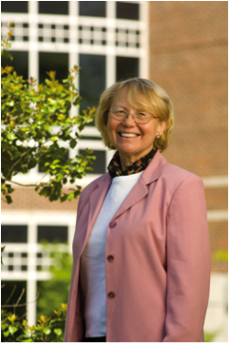
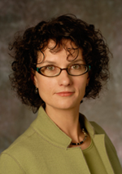
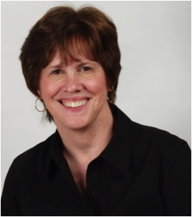
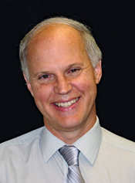
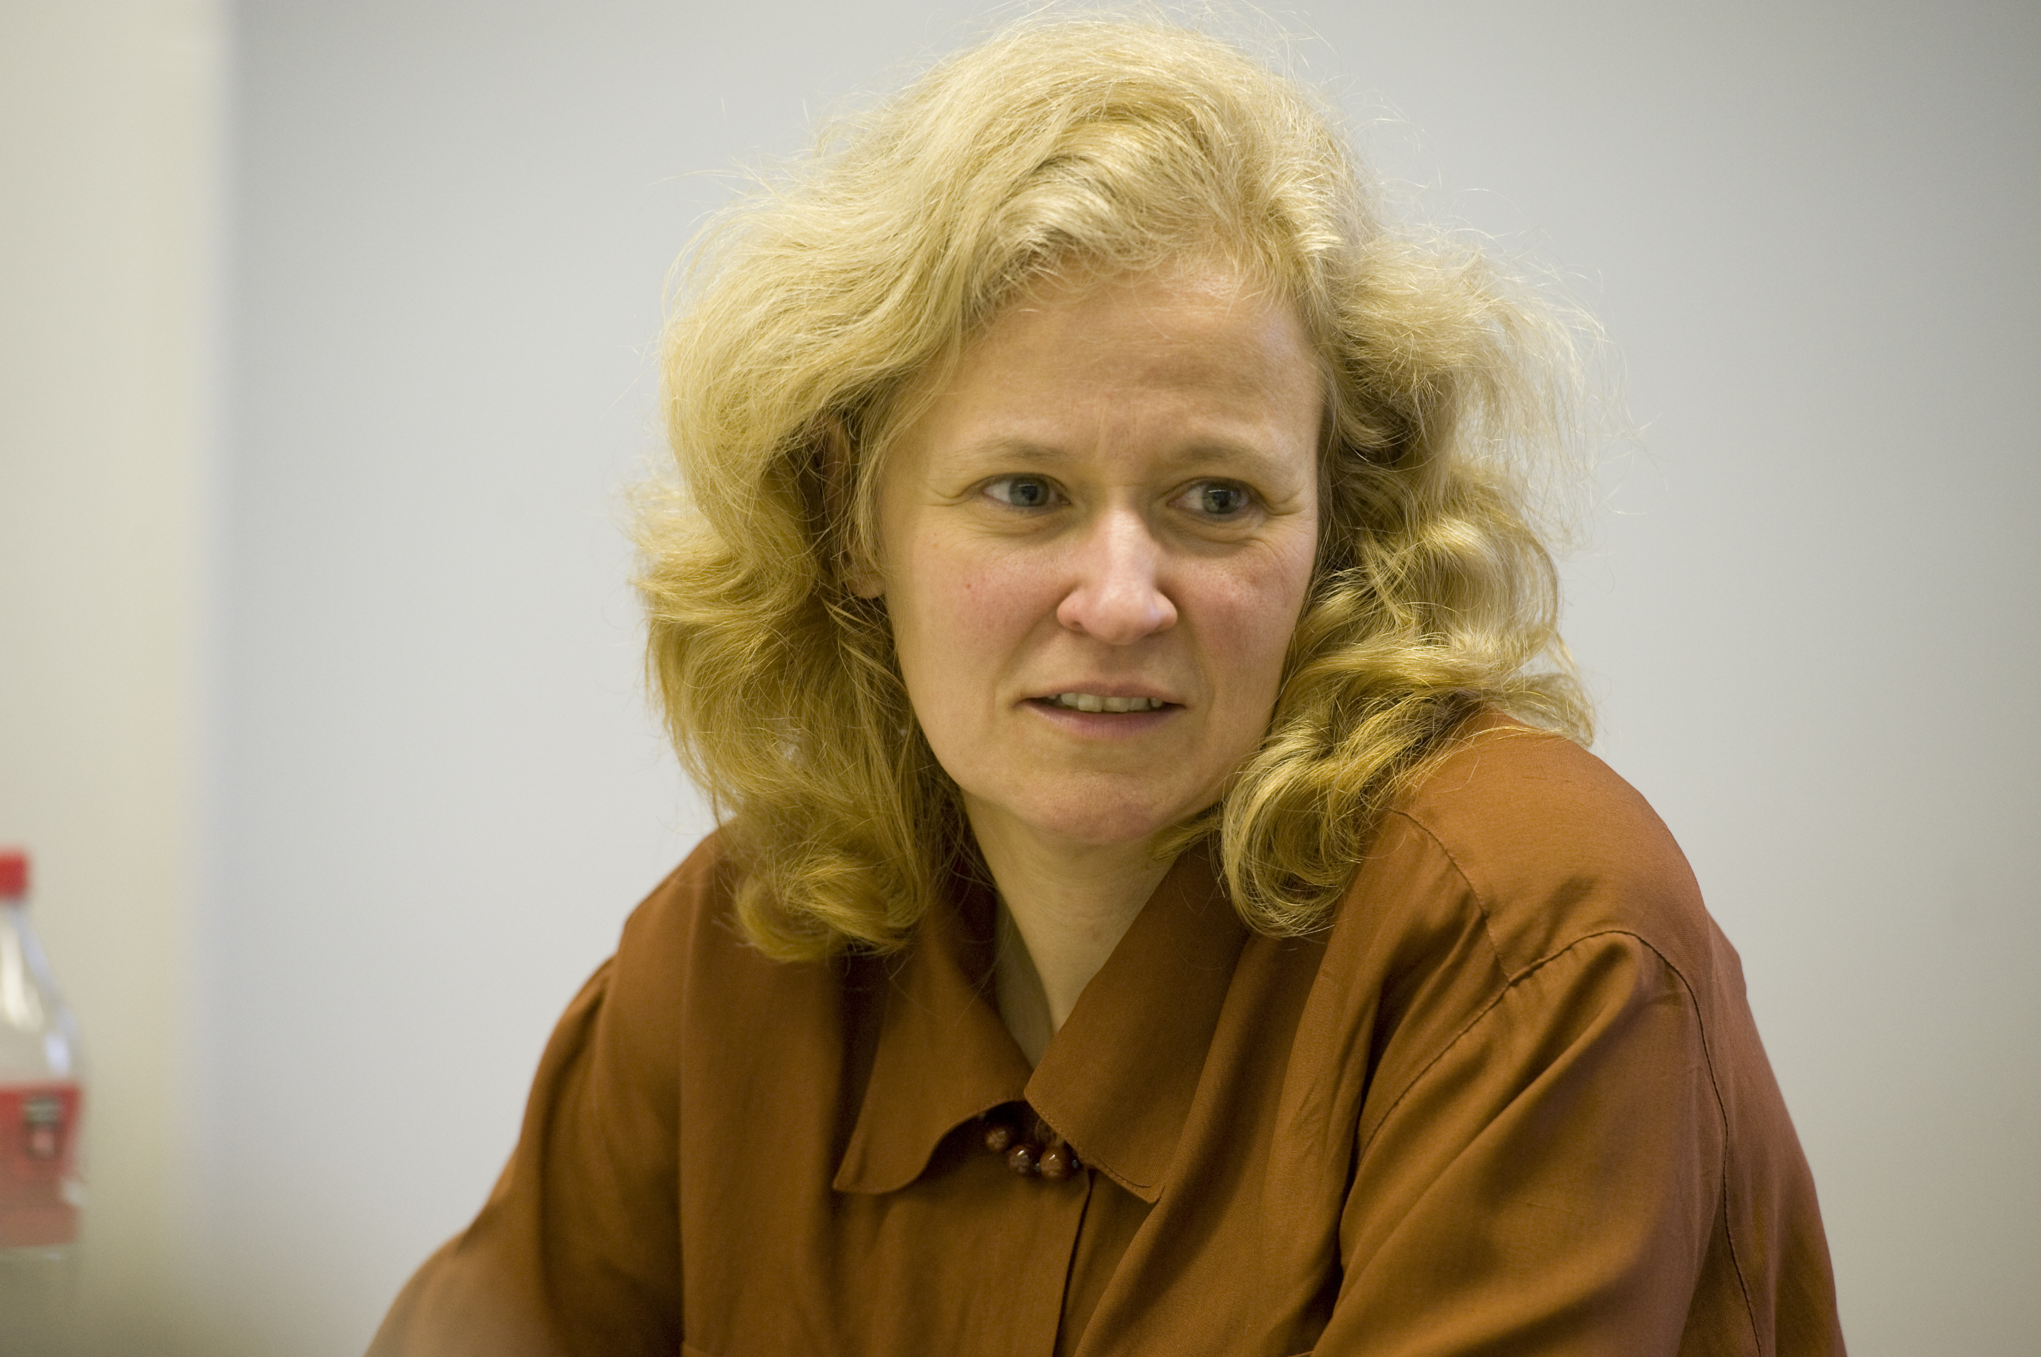
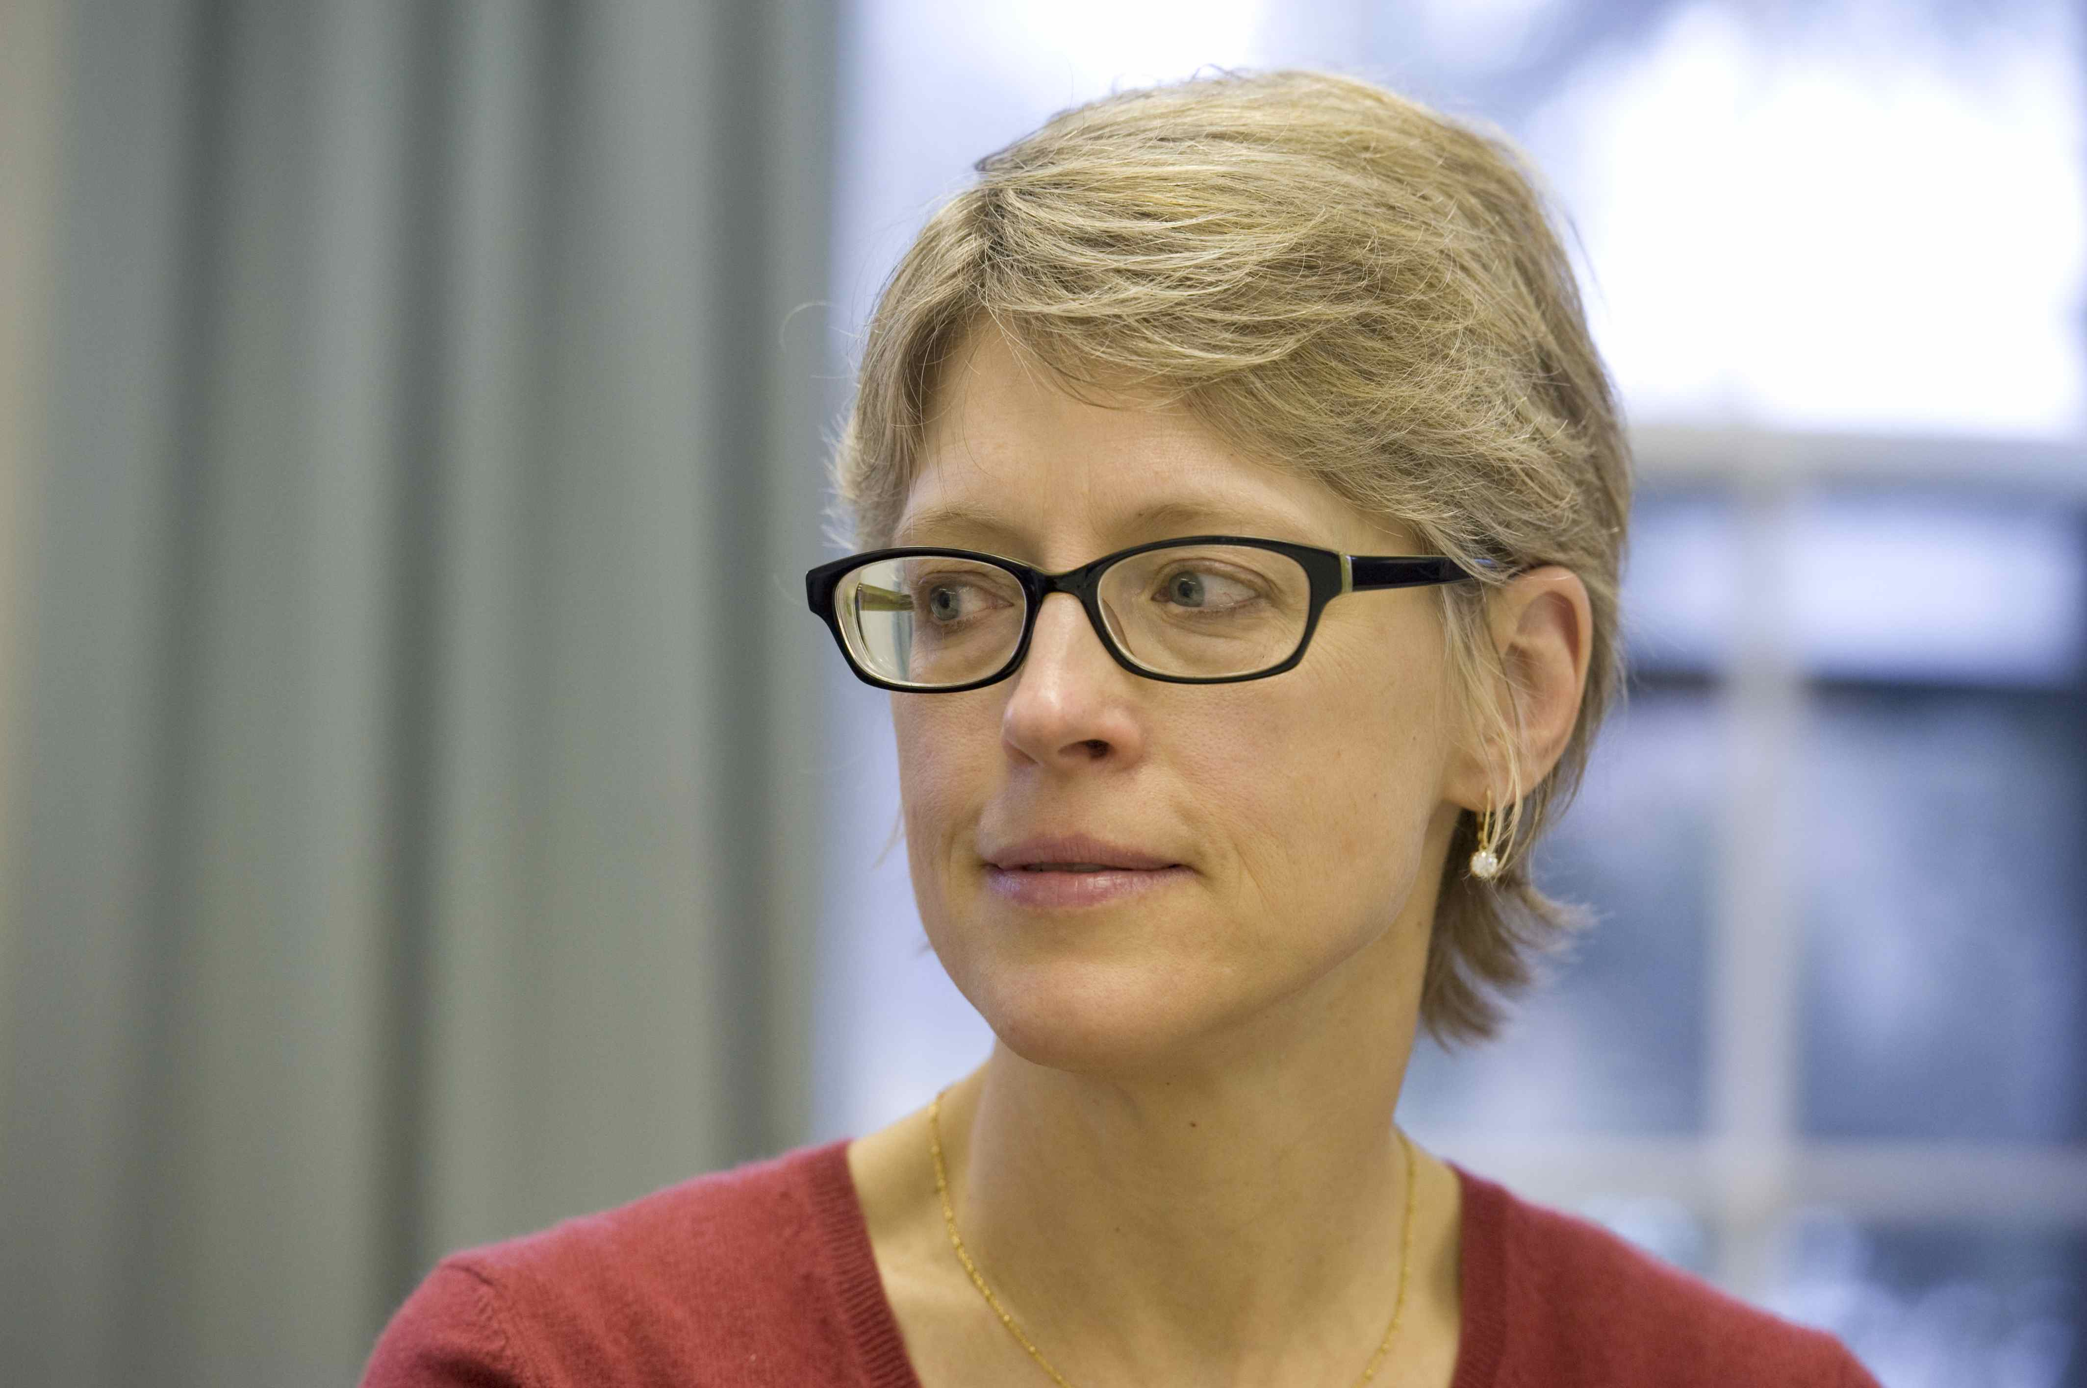
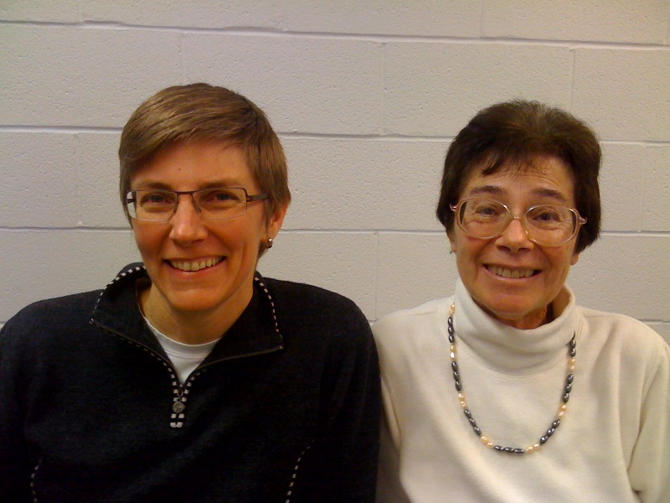
RU FAIR ADVANCE Executive Team
Joan W. Bennett
PI & Associate Vice President
Kathryn Uhrich
Co-PI & Dean of Math &
Physical Science,
New Brunswick
Patricia Roos
Co-PI & Professor
Philip Yeagle
Co-PI & Dean of Arts & Sciences, Newark
Helen Buettner
Co-PI, Professor & RU FAIR Professor New Brunswick
Georgia Arbuckle-Keil
RU FAIR Professor Camden
Judith Weis & Maggie Shiffrar
RU FAIR Professors
Newark

Slide 17
RU FAIR ADVANCE Executive Team
Staff
Doreen Valentine—Director of RU FAIR ADVANCE
Natalie Batmanian—Director of Leadership & Professional Development
Chanelle Ridgeway—Budget Manager
Christina Leshko—Program Coordinator
Carey Murray—Program Coordinator
Albertina Luchko—Communications Coordinator
Neng Wang—Development & Research Assistant
Graduate Students
Crystal Bedley
Alexis Merdjanoff
Undergraduate Students
Alvin Nyaboga
Lauren Miller
Nadia Khan

Slide 18
RU FAIR ADVANCE Governance
Internal Governance
Internal Advisory Board: 2008-2009
ADVANCE Consortium: 2010 – present
Action-based advisory board comprised of university deans, other key administrators, and dedicated faculty leaders that focuses on the institutionalization practices vital to ensuring diversity moving forward in the multi-campus university community
External Governance
External Advisory Board: 2008-present
Chair: Rutgers Executive Vice President Philip Furmanski
The members of the EAB are academic, business, and scientific leaders who have received national recognition for their work in organizational transformation and their commitment to diversity.

Slide 19
RU FAIR ADVANCE Evaluation
Formative (Internal) Evaluation
Summative (External) Evaluation
Mary McCain (2009-)
Program Evaluation
Focus groups and interviews
Event surveys
Mary Gatta (2008-2010) and Ronnie Kauder (2011-)

Slide 20
Research: From Toolkit Indicators to Mixed Methods Approaches
Patricia Roos, PhD
Co-PI of RU FAIR ADVANCE
Professor of Sociology
Director, Center for Women and Work

Slide 21
Institutional Data Collection and Research
Goal
Objectives
Assess progress
Facilitate gender and race equity research
Did we…
enhance leadership and professional development?
impact recruitment and retention?
Increase participation and leadership of women and underrepresented groups

Slide 22
Research
Indicator Toolkit
Quantitative
Interpret/contextualize
Mixed Methods
Institutional research
Gender/race equity studies
Connect research to impact
Evaluation
Formative
Summative

Slide 23
Institutional Partners for
Data Collection and Analysis
Creating a legacy
Enhance
Forge
Institutionalize
the University’s capacity to collect, systemize and analyze data on gender and race/ethnic equity
lasting partnerships among administrative and academic units
a data collection and data analysis capacity for gender and race/ethnic equity studies

Slide 24
Institutional Partners in Data Collection and Analysis
RU FAIR ADVANCE / SciWomen
Integration
  Administration
  Deans’ Offices
Toolkit
  OIRAP
  HR
Faculty Researchers
Data Warehouse

Slide 25
Summary of NSF Toolkit Indicators

Slide 26
Change in number and percent female SEM faculty*, by campus, AY 2007-08 to AY 2010-11
 | Number Female (Total) AY2007-08 | Percent Female AY2007-08 | Number Female (Total) AY2010-11 | Percent Female AY2010-11 | Percentage Change Female Faculty (t2-t1/t1)
University-wide | 205 (924) | 22.2% | 238 (979) | 24.3% | 16.1%
Camden | 22 (71) | 31.0% | 18 (69) | 26.1% | -18.2%
Newark | 35 (119) | 29.4% | 40 (131) | 30.5% | 14.3%
New Brunswick | 148 (734) | 20.2% | 180 (779) | 23.1% | 21.6%
Full-time tenured and tenure-track faculty
Toolkit Indicator Table 1

Slide 27
Change in number and percent female SEM faculty*, by campus and broad disciplinary group, AY 2007-08 to AY 2010-11
Campus | Division or School | Number Female (Total) AY2007-08 | Percentage Female AY2007-08 | Number Female (Total) AY2010-11 | Percentage Female AY2010-11 | Percentage Change Female Faculty (t2-t1/t1)
Camden | MPS | 4 (28) | 14.3% | 3 (28) | 10.7% | -25.0%
 | Biol Sci | 1 (8) | 12.5% | 0 (10) | 0.0% | -100.0%
 | SBS | 17 (35) | 48.6% | 15 (31) | 48.4% | -11.8%
Newark | MPS | 6 (32) | 18.8% | 6 (33) | 18.2% | 0.0%
 | Biol/Env | 6 (18) | 33.3% | 9 (26) | 34.6% | 50.0%
 | SBS | 17 (44) | 38.6% | 17 (44) | 38.6% | 0.0%
New Brunswick | MPS | 27 (213) | 12.7% | 27 (217) | 12.4% | 0.0%
 | Life Sci | 15 (50) | 30.0% | 15 (51) | 29.4% | 0.0%
 | SBS | 51 (152) | 33.6% | 59 (155) | 38.1% | 15.7%
 | SoE | 16 (128) | 12.5% | 19 (127) | 15.0% | 18.8%
 | SEBS | 29 (126) | 23.0% | 49 (175) | 28.0% | 69.0%
* Full-time tenured and tenure-track faculty Toolkit Indicator Table 1

Slide 28
Number of SEM Faculty* by Gender & Rank at Rutgers
AY2007-08 (baseline)
Bubble size represents percentage in rank
Women Men
Full-time Tenured & Tenure-Track
Toolkit Indicator Table 1

Slide 29
Number of SEM Faculty*
by Gender & Rank at Rutgers, AY2010-11
(with % change over baseline)
Bubble size represents percentage in rank
⬆ 2%
Women Men
Full-time Tenured & Tenure-Track
Toolkit Indicator Table 1

Slide 30
Gender & Rank at Rutgers, 2010-11
Tenured, Tenure-track & Non-tenure-track
Female SEM Faculty
Male SEM Faculty
Toolkit Indicator Table 2

Slide 31
Department Demographics at Baseline (2007-08)
Toolkit Indicator Table 1

Slide 32
Department Demographics in 2010-11
Toolkit Indicator Table 1

Slide 33
Race/ethnicity of SEM faculty at Rutgers, 2010-11
American Indian/
Alaskan Native
Asian/Pacific Islander
Black
Hispanic
White (all others)
 | Women |  |  |  | Men
Year | Under-represented (UR) | % UR | Total | Percentage Change | UR | % UR | Total | Percentage Change
AY2007-08 | 37 | 18.0% | 205 | — | 144 | 20.0% | 719 | —
AY2008-09 | 42 | 18.8% | 223 | ↑13.5% | 154 | 20.6% | 747 | ↑6.9%
AY2009-10 | 49 | 21.4% | 229 | ↑32.4% | 160 | 21.2% | 754 | ↑11.1%
AY2010-11 | 51 | 21.4% | 238 | ↑37.8% | 167 | 22.5% | 741 | ↑16.0%
Toolkit Indicator Table 9

Slide 34

Pre-ADVANCE Research
RU FAIR ADVANCE
2008-
Reaffirming Action
Ford Foundation grant
(PIs: Mary Hartman and Cheryl Wall)
FAS Committee on Increasing Faculty Diversity
(Mary Hartman, Chair)
FAS Gender Equity Study
(Noemie Koller, Chair)
1999

Slide 35
Mixed Methods Research:
Brokering for Institutional Change
RU FAIR Staff
RU FAIR Professors
Mini Grants
• Exit, entrance, stayer interviews
• Department chair interviews
• Space allocation study
• Career trajectory study
• Agents of change study
• Newark earnings study
• Camden time management study
• NB teaching evaluation study
• Associate professor project (Dana Britton)
• Network study
• Diversity study
• Multivariate earnings study
Evaluating RU FAIR activities: Assessing progress

Slide 36
Challenges and Successes
Challenges
  “1997 issue”
  Earnings measures: pay rate and beyond
Successes to Date
  Data warehouse
  University partnerships via ad hoc committee
  Integrating new Human Resources system (RIAS) (January 2011)
Future Successes
  Career trajectory study (analyzing cohorts)
  Multivariate earnings study (moving beyond descriptive analysis)

Slide 37
Meta-Initiative #1:
Recruitment and Retention
Doreen Valentine, PhD
Director of RU FAIR ADVANCE &
Assistant Director in the Office for the Promotion of Women in Science, Engineering, and Mathematics

Slide 38
Meta-Initiative #1: Recruitment & Retention
Develop a targeted strategy for increasing the number of women in general, and minority women in particular, on the SEM faculty of Rutgers University through…
  Professional development on best practices for faculty search committees (RU InSTRIDE)

Slide 39
RU InStride
(Institutionally Novel Strategies and Tactics to Improve Diversity and Excellence)
Modeled after University of Michigan’s STRIDE Initiative
Committee of distinguished faculty and administrative leaders
Develop and implement guidelines for best practices in hiring
Liaison with central administration and decanal units

Slide 40
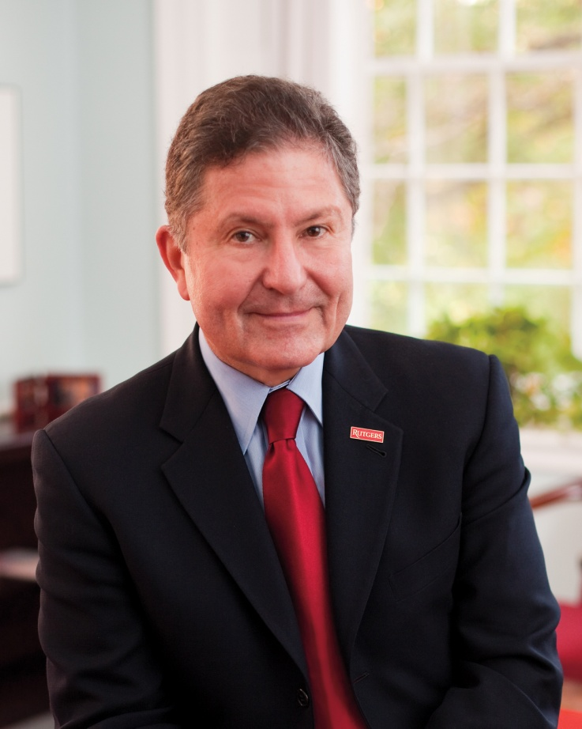
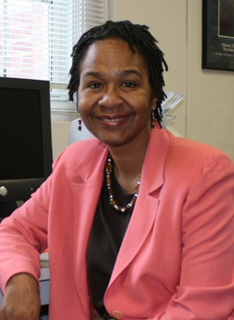
The President’s Council for Institutional Diversity and Equity emerged as the InSTRIDE body at Rutgers
Co-chairs
Charged with actively monitoring the university’s progress in diversifying its faculty and senior administration
Provides guidance to chairs and deans regarding best practices in faculty hiring, retention, and campus climate and community
Makes recommendations regarding proposals submitted under the President’s Faculty Diversity Cluster Hiring Initiative
Formed science subcommittee to address issue of cluster hiring in SEM
President Richard L. McCormick
Cheryl Wall, Zora Neale Hurston Professor of English
Comprised of 33 administrative and faculty leaders from Rutgers’ three campuses

Slide 41
Institutional Partnerships for RU InStride
RU FAIR ADVANCE/
SciWomen
Deans, Faculty & Central Administration
  Camden
  Newark
  New Brunswick
President’s Council on Institutional Diversity & Equity
Office of Institutional Diversity & Equity
Best Practices for Faculty Recruitment & Retention

Slide 42
RU InStride Timeline
2007 - 2008
2008 - 2009
2009 - 2010
2010 - 2011
Female Faculty:
205/924; 22.2%
UR Faculty:
181/924; 19.6%
Female Faculty:
⬆16.1%
238/979; 24.3%
UR Faculty: ⬆20.4% (218/979; 22.3%)
President’s Council on Institutional Diversity & Equity established
Science subcommittee
established
“Increasing Faculty Diversity” handbook published
Development & roll-out of online resource module & website
RU FAIR outreach to department chairs & faculty
Professional Development Workshops for Departmental Search Committees (future)
Mini-grant programs on “Unconscious Bias” & “Evaluation of Competence & Merit” research

Slide 43
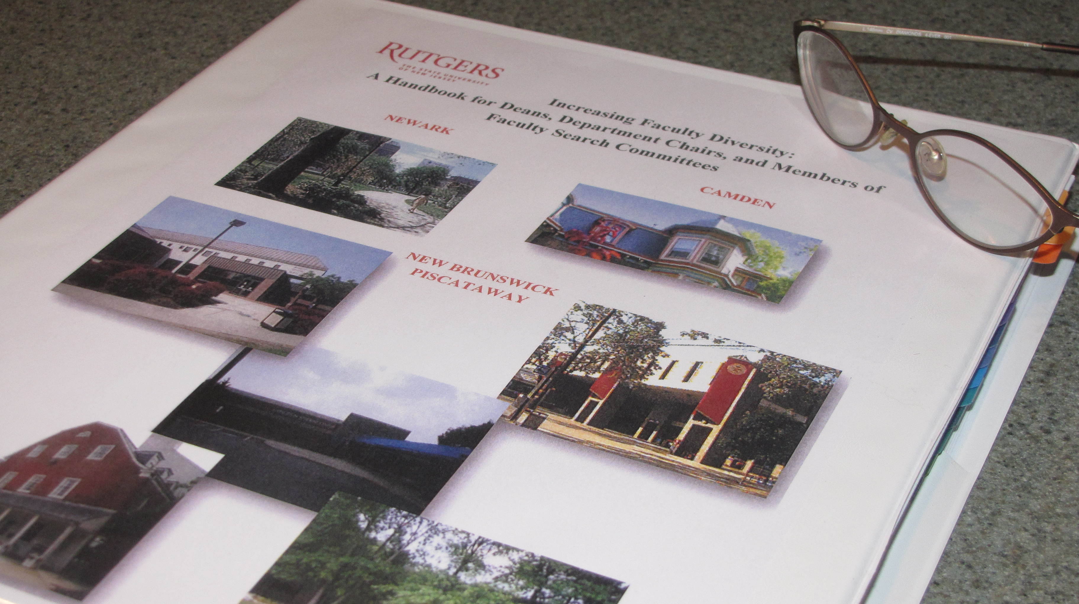
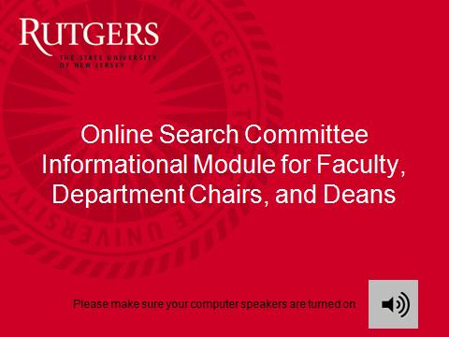
From Handbook to Online Module
Institutional
partnerships
Expertise:
Subject-matter
Process
Technical
Multi-stage
implementation
and roll-out
Create buy-in
through active
feedback &
participation
http://search.committee.module.rutgers.edu

Slide 44
Active Recruitment in the Digital Age
Handbook
(2009)
Online
Interactive
Module
(2010)
Web-Based
Resource
Suite
(2011)
Professional
Development
Workshops
(2011)
Passive
Detailed Resources
Online (pdf)
References with hyperlinks
Print reference
Active/Interactive
Professional development (skills training)
Multimedia
Self-assessment
Compliance
Integrated
Multimedia
Multi-module
Webliography
Threaded discussions
Customized
Professional development
Group discussions
Onsite training
Evaluation

Slide 45
New Hires in SEM at Rutgers
AY2007-08 to AY2009-10
% Women
5
31
13.9%
40.0%
30.0%
29.3%
20
30
9
21
5
34
34
Women Men
Number of Faculty Hired
Toolkit Indicator Table 7

Slide 46
New Hires in SEM by Campus
AY2007-08 to AY2009-10
29.0%
Women Men
66
27
40.0%
9
12.5%
6
1
7
Toolkit Indicator Table 7

Slide 47
Committee on the Future of the School of Arts and Sciences, New Brunswick Executive Dean Douglas Greenberg
Strategic Goals and Tactical Steps—2010
Triple, within five years (2016), the number of women faculty members in the life sciences and the mathematical and physical sciences
Triple, within five years (2016), the number of people of color on the SAS faculty
New Hires in SAS-NB
About half of new hires between AY2007-08 and AY2009-10 have been women:
  Life Sciences (n=3/6)
  Social and Behavioral Sciences (n=9/19)
In the current year (AY2010-11):
  Mathematics and Physical Sciences (n=3/6)

Slide 48
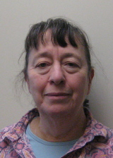
Successful Recruitment in Department of Mathematics-New Brunswick
5 female mathematicians invited for a guest lecture series
Mechanism of Support: Mini-grant
executive leadership takes decisive action
3 offers made
2 accepted
leads to a cluster recruitment and hiring
Mini-grant Recipient:
Professor Amy Cohen-Corwin
AY2009-10
  Math Dept comprised of 62 men and 2 women (3.1% female)
AY2010-11
  Math Dept comprised of 60 men and 4 women (6.3%)
Notes:
48

Slide 49
New Hires (Tenured/Tenure-track SEM Faculty) AY2007-08 — AY2009-10
School of Environmental & Biological Sciences
38.9% (n=7/18) of new hires were women
Percent female faculty, AY2010-11 = 28.0% (↑69.0%*)
School of Engineering
27.3% (n=3/11) of new hires were women
Percent female faculty, AY2010-11 = 15.0% (↑18.8%)
Faculty of Arts & Sciences – Newark
42.9% (n=6/14) of new hires were women
Percent female faculty, AY2010-11 = 30.3% (↑16.1%)
Faculty of Arts & Sciences – Camden
12.5% (n=1/8) of new hires were women
Percent female faculty, AY2010-11 = 26.3% (↓18.2%)
Toolkit Indicator Table 7
Toolkit Indicator Table 1

Slide 50
New SEM Hires by Gender & Rank,
AY2007-08 to AY2009-10
33.7%
% Women (total hires)
= 29.3% (116)
57
Women Men
28.6%
7.7%
0.0%
29
10
12
3
0
Toolkit Indicator Table 7

Slide 51
Retention: Tenure Outcomes by Gender
AY2007-08 to AY2009-10
32.9%
35.3%
% Assistant Women in AY2009-10
= 38.3% (141)
49
44
Women Men
24
24
0.0%
0
5
Full-time tenure-track SEM faculty
Toolkit Indicator Table 3

Slide 52
Promotion Outcomes by Gender: Associate to Full Professor, AY2007-08 to AY2009-10
23.2%
% Associate Women in AY2009-10
= 31.4% (261)
25.0%
53
Women Men
45
11.1%
16
15
1
8
Full-time tenured SEM faculty
Toolkit Indicator Table 4

Slide 53
Promotion Outcomes by Gender: PI to PII AY2007-08 to AY2009-10
% PI Women in AY2009-10
= 17.6% (369)
16.7%
21.1%
Women Men
20
15
0.0%
4
4
5
0
Full-time tenured SEM faculty
Toolkit Indicator Table 4

Slide 54
Retention: Keep them here. Help them thrive.
Enhance retention by providing resources for successful promotion outcomes
Faculty Resource Toolkit
Mentors—formal & informal
Professional networks
Enhanced visibility
Work-life balance
Childcare options
Grantsmanship: from sources to writing
Tenure & promotion support
Notes:
-

Slide 55
RU FAIR Mechanisms for Retention
Mini-grants: 22 mini-grants supported 20 lectures or colloquia, 7 workshops, 7 research projects, and networking
Life-Cycle grants: 7 faculty facing significant personal challenges supported at critical career junctures
Mini-grants by discipline
Mini-grants by type
Notes:
-

Slide 56
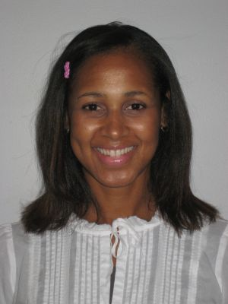
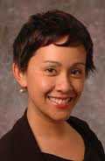
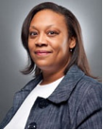
Women of Color Scholars Project
Objectives
Address challenges facing junior women of color as emerging scholars scientists and teachers through:
    Workshops for skill-building
    Senior and peer mentoring
    Documenting experiences of women of color in academia and SEM disciplines
    Creating tight-knit community
Zaire Dinzey-Flores
Assistant Professor
Latino Studies and
Sociology
Robyn Rodriguez
Assistant Professor
Sociology
Niki Dickerson
von Lockette
Associate Professor
Labor Studies & Employment Relations
Participants & Programs
  ~12 regular participants and 10 occasional participants
  10 workshops, symposia and networking events to date
Notes:
--

Slide 57
Women of Color Scholars Project
Assessing Progress & Impact
  Web-based forum for exchange of ideas and consensus building
  Focus group evaluation
  Programmatic evaluation
“The group has turned out to be nothing short of necessary, in my estimation, for the success of women of color faculty.” ~assistant professor at focus group
“I mean Rutgers is huge...transitioning from doing your research to dealing with students and colleagues, it’s a really difficult experience....It’s not just me, [the WoC group] made the experience less isolating.” ~assistant professor at focus group
“I benefited from the systematic way the two speakers took us through the tenure process, the insights they shared on key components of a tenure file (such as outside letters), and the reminder to be taking steps now to ensure success later.” ~assistant professor at T&P workshop

Slide 58
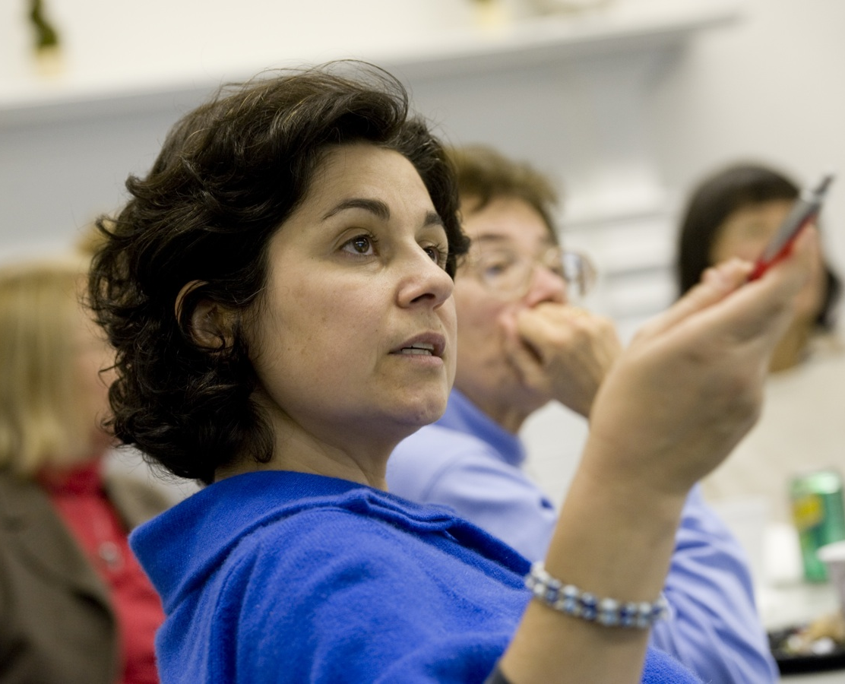
Meta-Initiative #2:
Leadership &
Professional Development
Natalie Batmanian, PhD
Director of Leadership and Programs &
Associate Director in the Office for the Promotion of Women in Science, Engineering, and Mathematics

Slide 59
Goal
Enhance women’s full participation advancement and leadership
,
Visibility
Achievements
Administrative Roles
Advancement in Rank

Slide 60
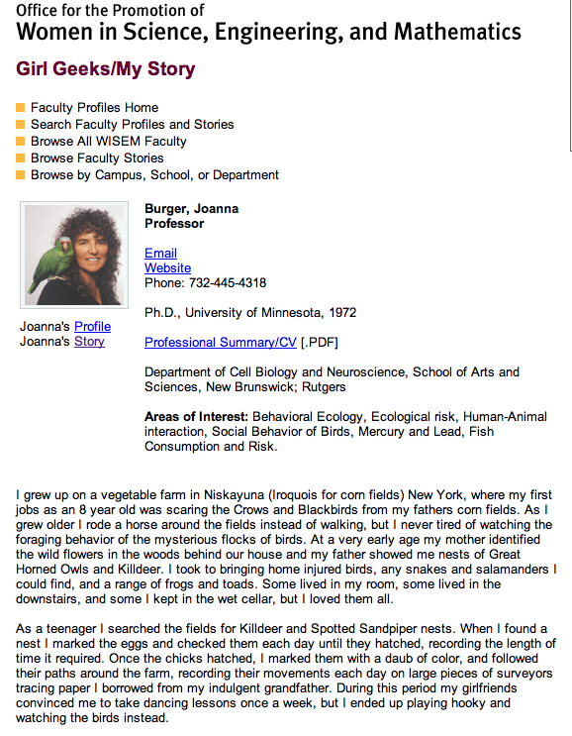
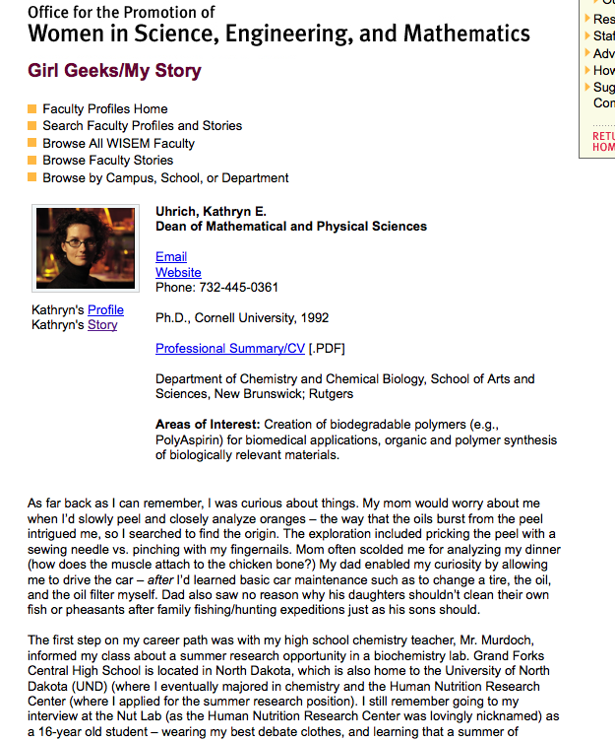
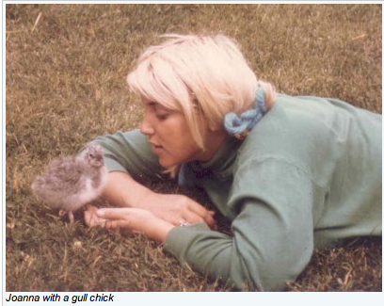
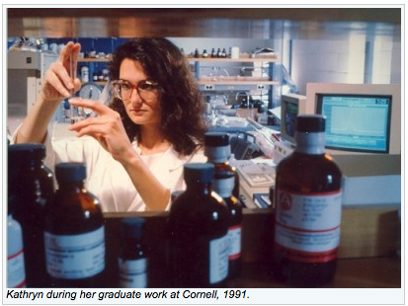
Faculty Visibility: My Stories
A mentoring tool for the digital age

Slide 61
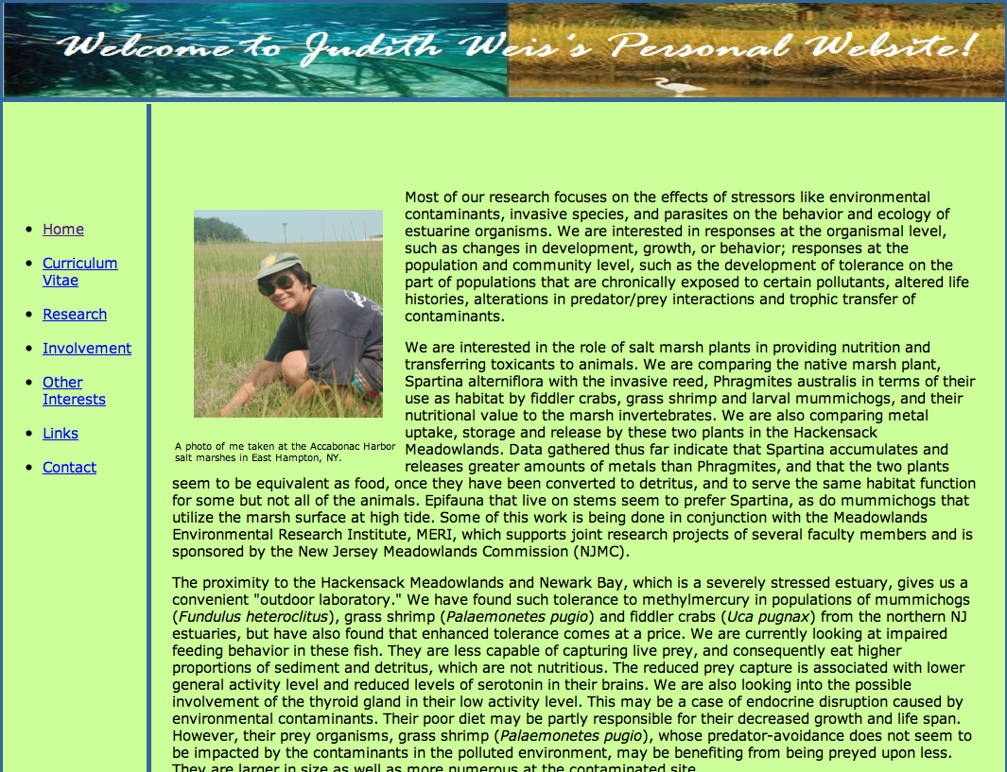

Faculty Visibility in Newark
Professor of biology Judith Weis and 10 other SEM female faculty updated their websites for more effective communications and visibility.
http://newarkbioweb.rutgers.edu/Weis%20Lab/index.html

Slide 62
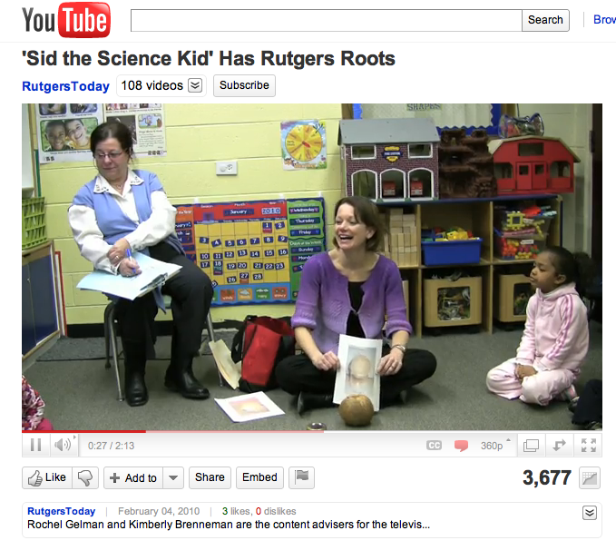
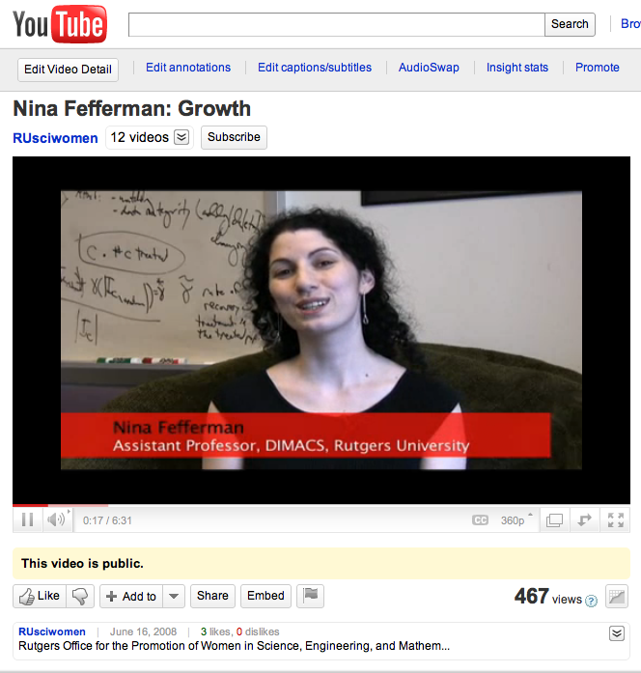
Faculty Visibility on the Internet

Slide 63
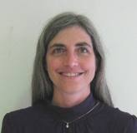
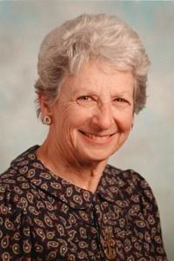
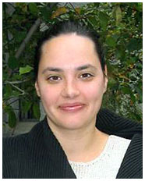
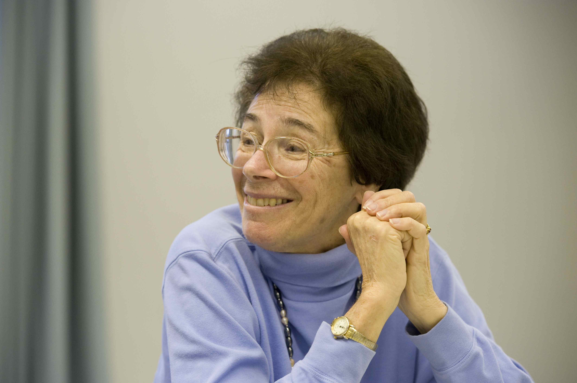
Faculty Achievements: Awards
Only 17% of the awards given out to STEM fields since 1987 have been given to women.
The RAISE Project
Dr. Barbara Turpin
Professor,
Environmental Sciences
Awarded 2011 Fellow of American Association for the Advancement of Science
Dr. Noemie Koller
Professor, Physics
Awarded 2010 Nicholson Medal for Human Outreach
by the American Physical Society
Dr. Helen Buettner
Professor, Engineering and
RU FAIR Professor and Co-PI
Awarded 2010 WEPAN
University Change Agent Award
Dr. Judith Weis
Professor, Biology and RU FAIR Professor
Chair of NJ DEP Science Advisory Board
Dr. Diana Sanchez
Assistant Professor,
Psychology
Awarded
2010 Michele Alexander
Early Career Award for
Scholarship and Service

Slide 64
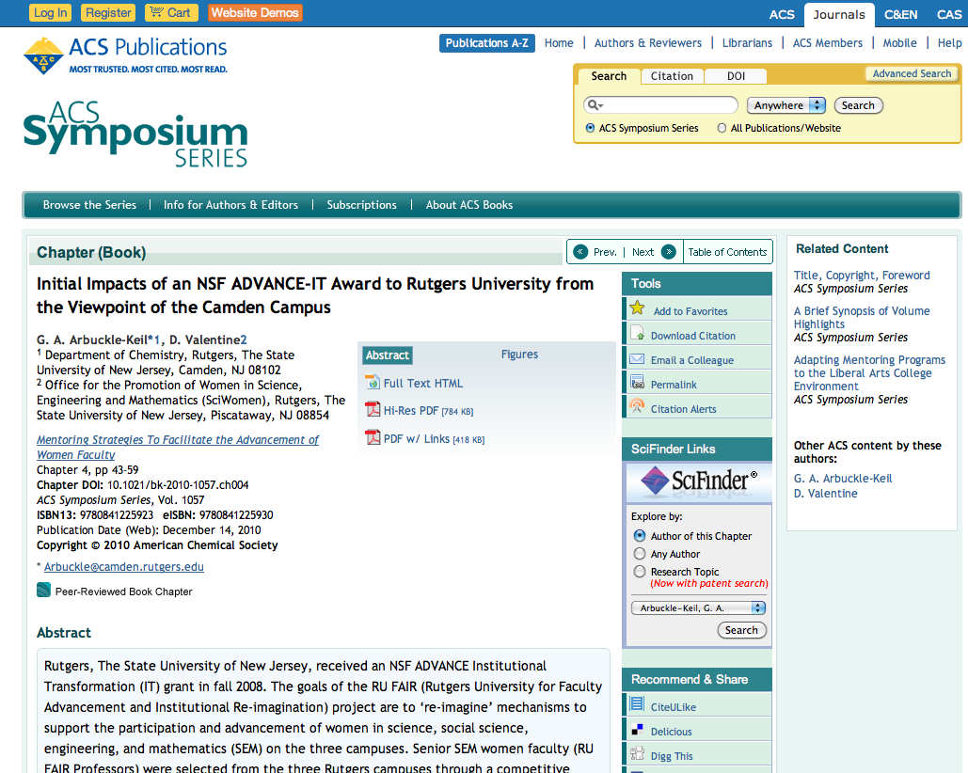
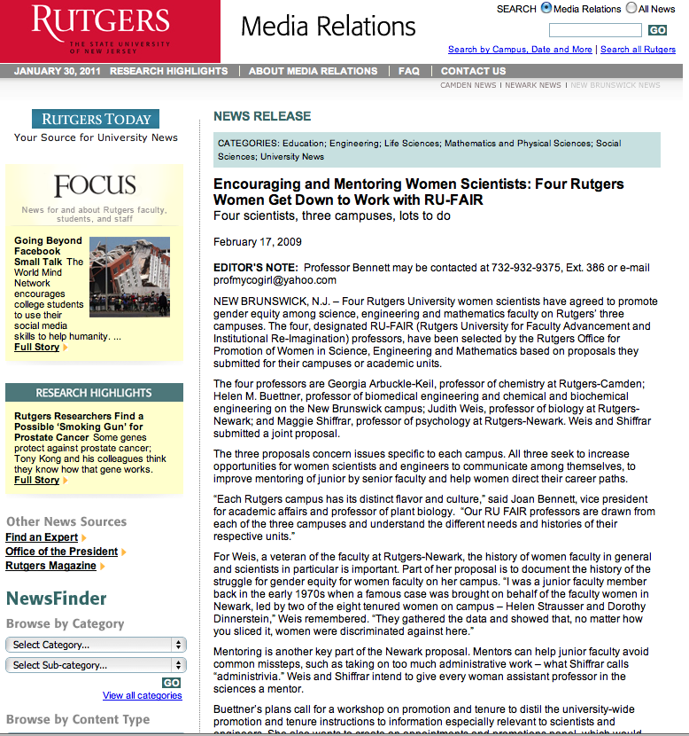
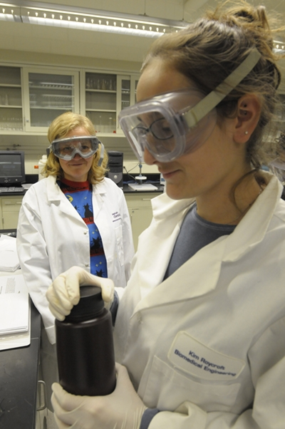
Faculty Achievements: In the News

Slide 65
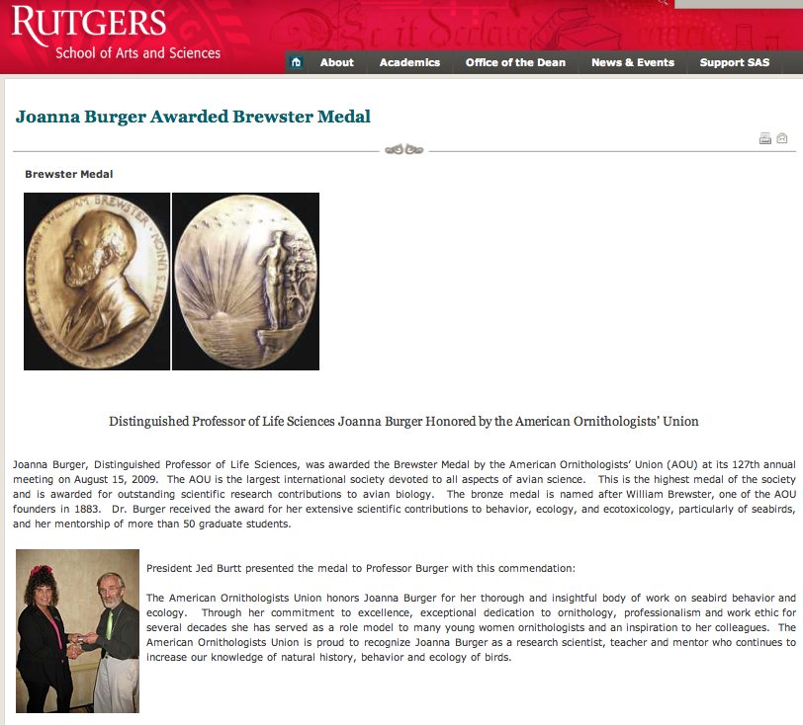
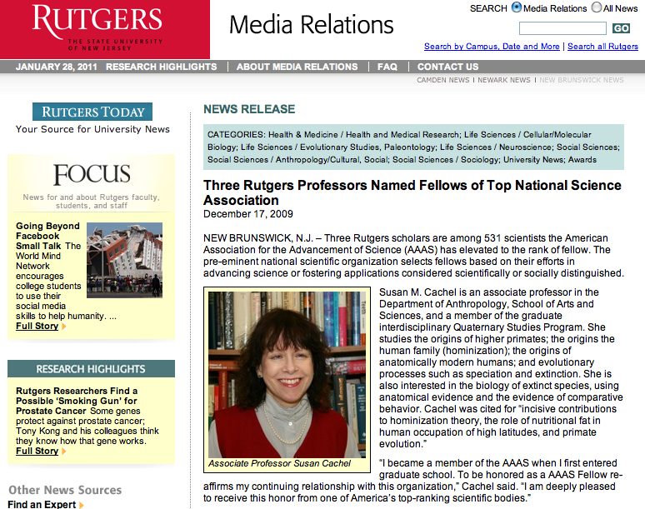
Faculty Achievements: In the News

Slide 66
Number of SEM Faculty*
by Gender & Rank at Rutgers, AY2010-11
Bubble size represents percentage in rank
Women Men
Full-time Tenured & Tenure-Track
Toolkit Indicator Table 1

Slide 67
University Leaders
AY2007-08 to AY2010-11*
% Women
2010-11
(2007-08)
4.2%
(12.5%)
48.6%
(32.4%)
22.4%
(10.3%)
17.7%
(18.7%)
18.7%
(17.8%)
26.9%
(24.8%)
*Data for
“Special Professors” as of 8/10
Women Men
Toolkit Indicator Table 8

Slide 68
SEM Department Chairs at Rutgers
Women
Men
*Dean of the School of Criminal Justice excluded
Toolkit Indicator Table 8

Slide 69
Leadership & Professional Development Programs Available for Women at Rutgers
Center for Organizational Development and Leadership (ODL)
Targets leaders in higher education
Executive Leadership Program (ELP)
Developed by Institute of Women’s Leadership for executive women in industry
SciWomen OASIS
Targets faculty women in science
Notes:
DV: SciWomen OASIS—should use “faculty” here?

Slide 70
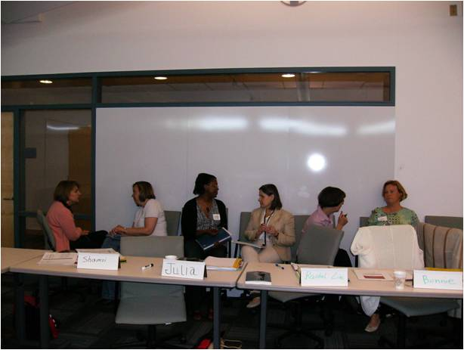
OASIS
(Objective Analysis of Self and the Institute Seminar)
Modeled after ELP
Customized to address common themes within the context of academic science
  Leadership Skills (communication, negotiation…)
  Professional networks
  Work-life balance
  Research Collaborations

Slide 71
OASIS impacts…
Leadership and Professional Development
  Skill building and mentoring
  Resource toolkits
Networking Opportunities
  Creating and sustaining networks for professional exchange
Workplace and Community
  Reducing isolation
  Raising productivity and job satisfaction
Research Collaborations
  Entrepreneurial ventures

Slide 72
Approach and Philosophy
Skill building
to prepare for leadership roles
Workshop series
Mentoring
to maximize learning and improve mentoring skills
Peers and senior women
One-on-one coaching sessions
to create action plans for personalized goals
Monthly meetings
Networking
to build and expand alliances and communities
Networking during program and beyond

Slide 73
OASIS Skill-building Approaches
Improving self-advocacy
Negotiation
Improving leadership skills
Understanding one’s leadership style
Balancing work and life
Scientist as entrepreneur
Prioritizing work and life demands
Communicating one’s science
Leading versus managing
Managing time
Funding and budgeting
Building alliances

Slide 74
OASIS Mentoring Approaches
Peer
Peer
Peer
Peer
Peers share information and experiences
Peer Mentoring
Mosaic of Mentors
Mentoring Circles
Protégé
Mentor 1
Mentor 2
Mentor 3
Mentor 4
Senior-rank
Faculty
Junior
Junior
Junior
Junior
Protégé receives mentoring through a series of brief encounters
Support reaches more
people at once

Slide 75
RU FAIR OASIS – Camden
In Fall 2010, RU FAIR Professor Georgia Arbuckle-Keil designed and ran the OASIS-Camden Leadership Program.
Disagree Agree
1-----------2----------3----------4----------5
Overall effectiveness of the program
Participants
Outcomes
16 women in SEM
27 total
Program rated “well-delivered and useful”

Slide 76
Evolution of SciWomen OASIS
2008
2009
2010
2011
PROGRAMMING
OASIS I
Pilot with 29 Faculty Members in SEM fields
OASIS II Program – 71*
OASIS Coaching and Mentoring - 21
OASIS III
Camden
16
OASIS NB – 20 expected
OASIS Peer-mentoring Circle
12
FUNDING
Academic Excellence and
Office of Diversity and Equity Funds
Bio1-Wired
NJ Department of Labor
RU FAIR ADVANCE
Numbers reflect participating women faculty members in SEM
* includes women from industry

Slide 77
OASIS Circle: Peer Mentoring Group
Spring 2010 - present
A forum for senior-rank women to
Discuss professional issues
Develop a community that extends beyond their immediate departments
Voice issues for women in science
Brainstorm solutions
OASIS Circle members have committed to mentoring early-career colleagues in the Spring 2011 OASIS Leadership and Professional Development Program

Slide 78
OASIS Participants to Date
Public (e.g., K-12 Administrators in Science)
Private (e.g., Pharmaceutical and IT Sector)

Slide 79
Academic Participants in OASIS
(Rutgers and Other Institutions)

Slide 80
OASIS Program Evaluation
    Disagree 1--------2-------3-------4-------5 Agree
Overall effectiveness of the program
% of Ratings of 4 or Above
100%
95%
95%
95%
Recommend the program to others
Program was beneficial to them
Feel better prepared for leadership roles
Prepared to negotiate successfully with supervisors and colleagues
90%
Think program prepared them with a better career plan

Slide 81
What participants are saying…
Biggest benefit was networking… getting to know other women who are scientists.
I feel isolated here… this was so supportive.
Helped in building confidence, networking, and formation of ideas and opinions about women in workplace.
Every university needs a professional development program like OASIS.
I am so glad that I made the time for this program. It is something we, in academia, should do more of.

Slide 82
Amplifying RU FAIR ADVANCE through OASIS
Provides intellectual and resource exchange
Provides networking within school and across campuses
Communicates diversity and equity goals mutual to Rutgers and ADVANCE
Helps reach retention goals mutual to Rutgers and ADVANCE

Slide 83
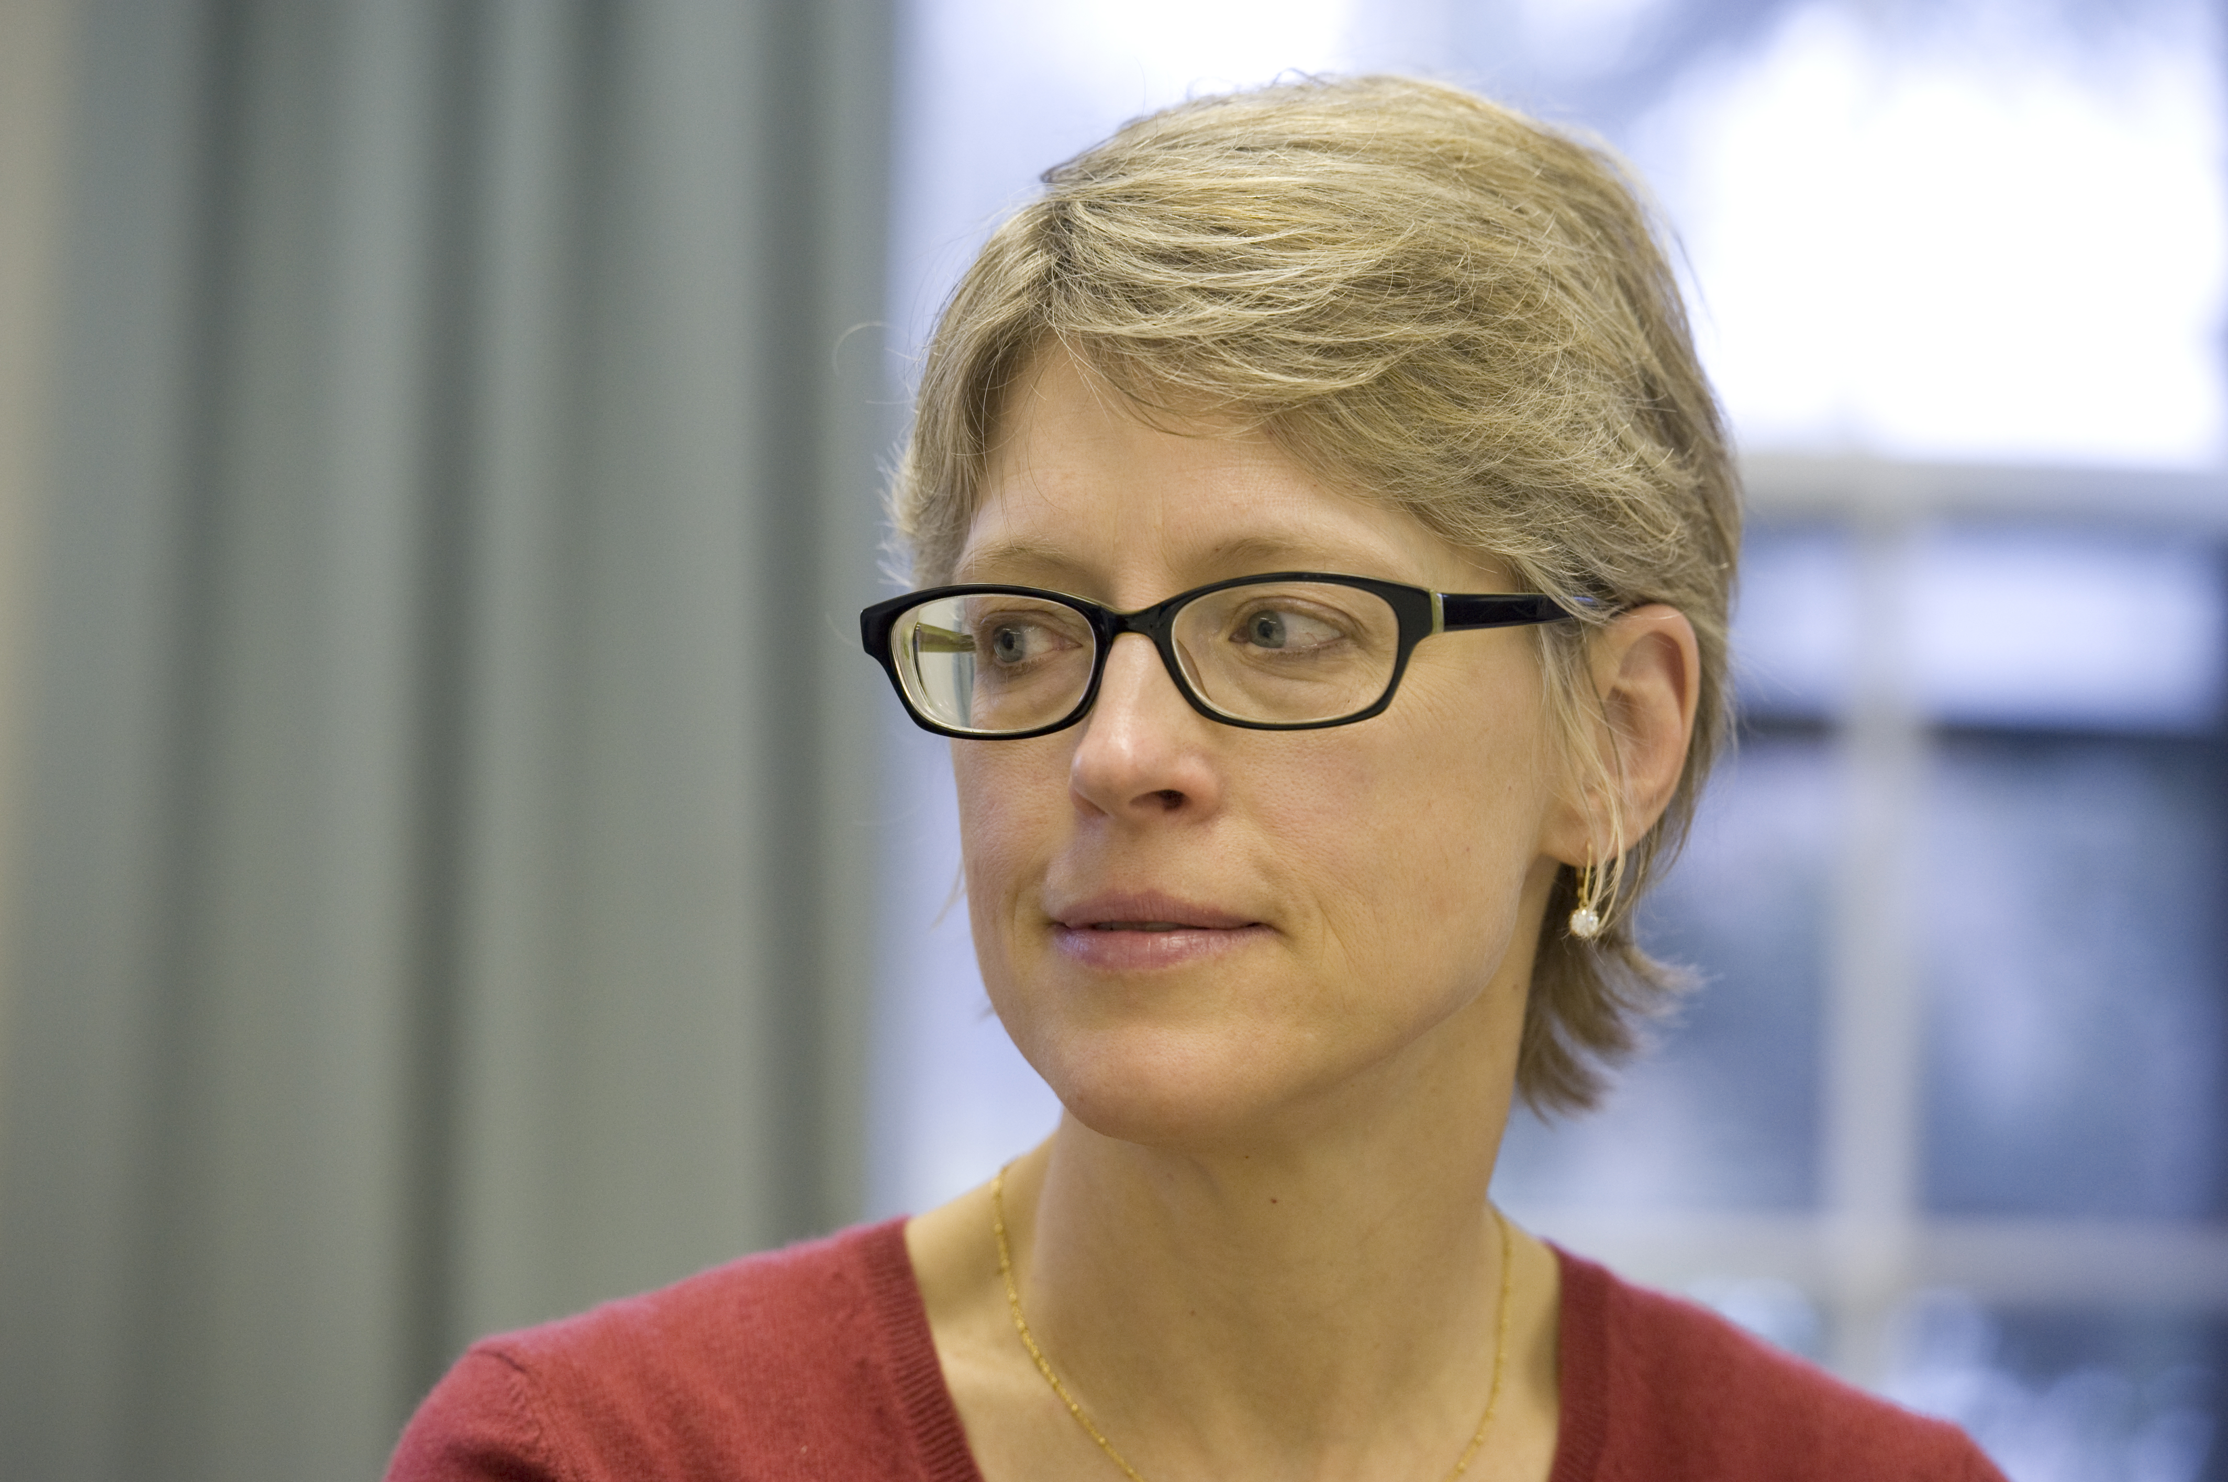
RU FAIR Professorships and Concluding Thoughts
Helen Buettner, PhD
Co-PI and
RU FAIR Professor -
New Brunswick
Professor of
Biomedical Engineering

Slide 84
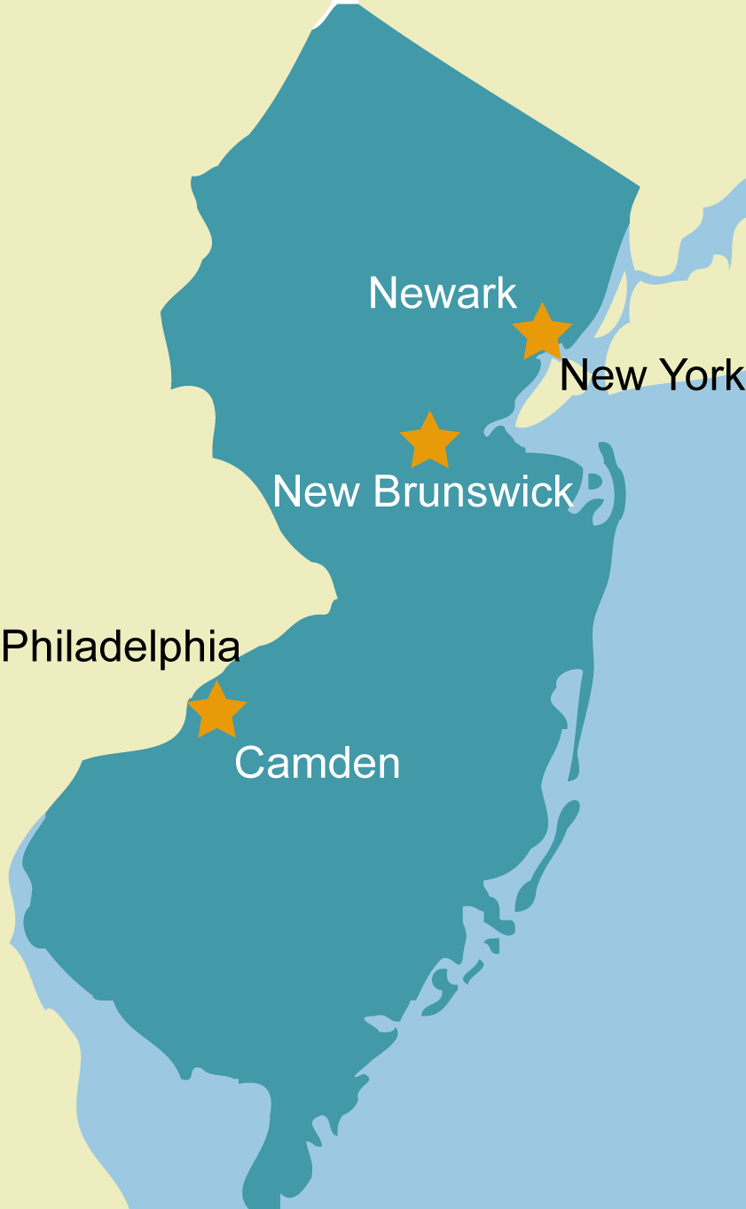
Connecting Our Three Campuses
The RU FAIR Professorship Program
addresses campus-specific needs through grassroots initiatives
increases communication across campuses
Decentralization presents a strength and a challenge for Rutgers

Slide 85
Who are RU FAIR Professors?
Campus Ambassadors
Representatives of ADVANCE
Sponsors and Advocates
SEM women
Grassroots Facilitators
Gender and race/ethnic diversity, equity, and excellence
SEM women’s advancement through tailored programs, lecture series, and mentorship
Enhance visibility and communication on respective campuses and across disciplines and campuses

Slide 86
RU FAIR Professors on Each Campus
Helen Buettner
Professor of Biomedical Engineering and Chemical & Biochemical Engineering
Georgia
Arbuckle-Keil
Professor of Chemistry
Judith Weis
Professor of Biology
Maggie Shiffrar
Professor of Psychology
CAMDEN
NEWARK
NEW BRUNSWICK

Slide 87
RU FAIR Professors in Newark
Maggie Shiffrar and Judith Weis
Context
Most diverse campus
History of civil rights
Concentration of professional schools
Research and Programming Highlights
Newark Faculty Salary Study
Enhanced visibility via website, forging relationships with program officers in Washington
Distinguished Lecture Series
Child Care Center development
Historical Perspective on Gender Equity

Slide 88
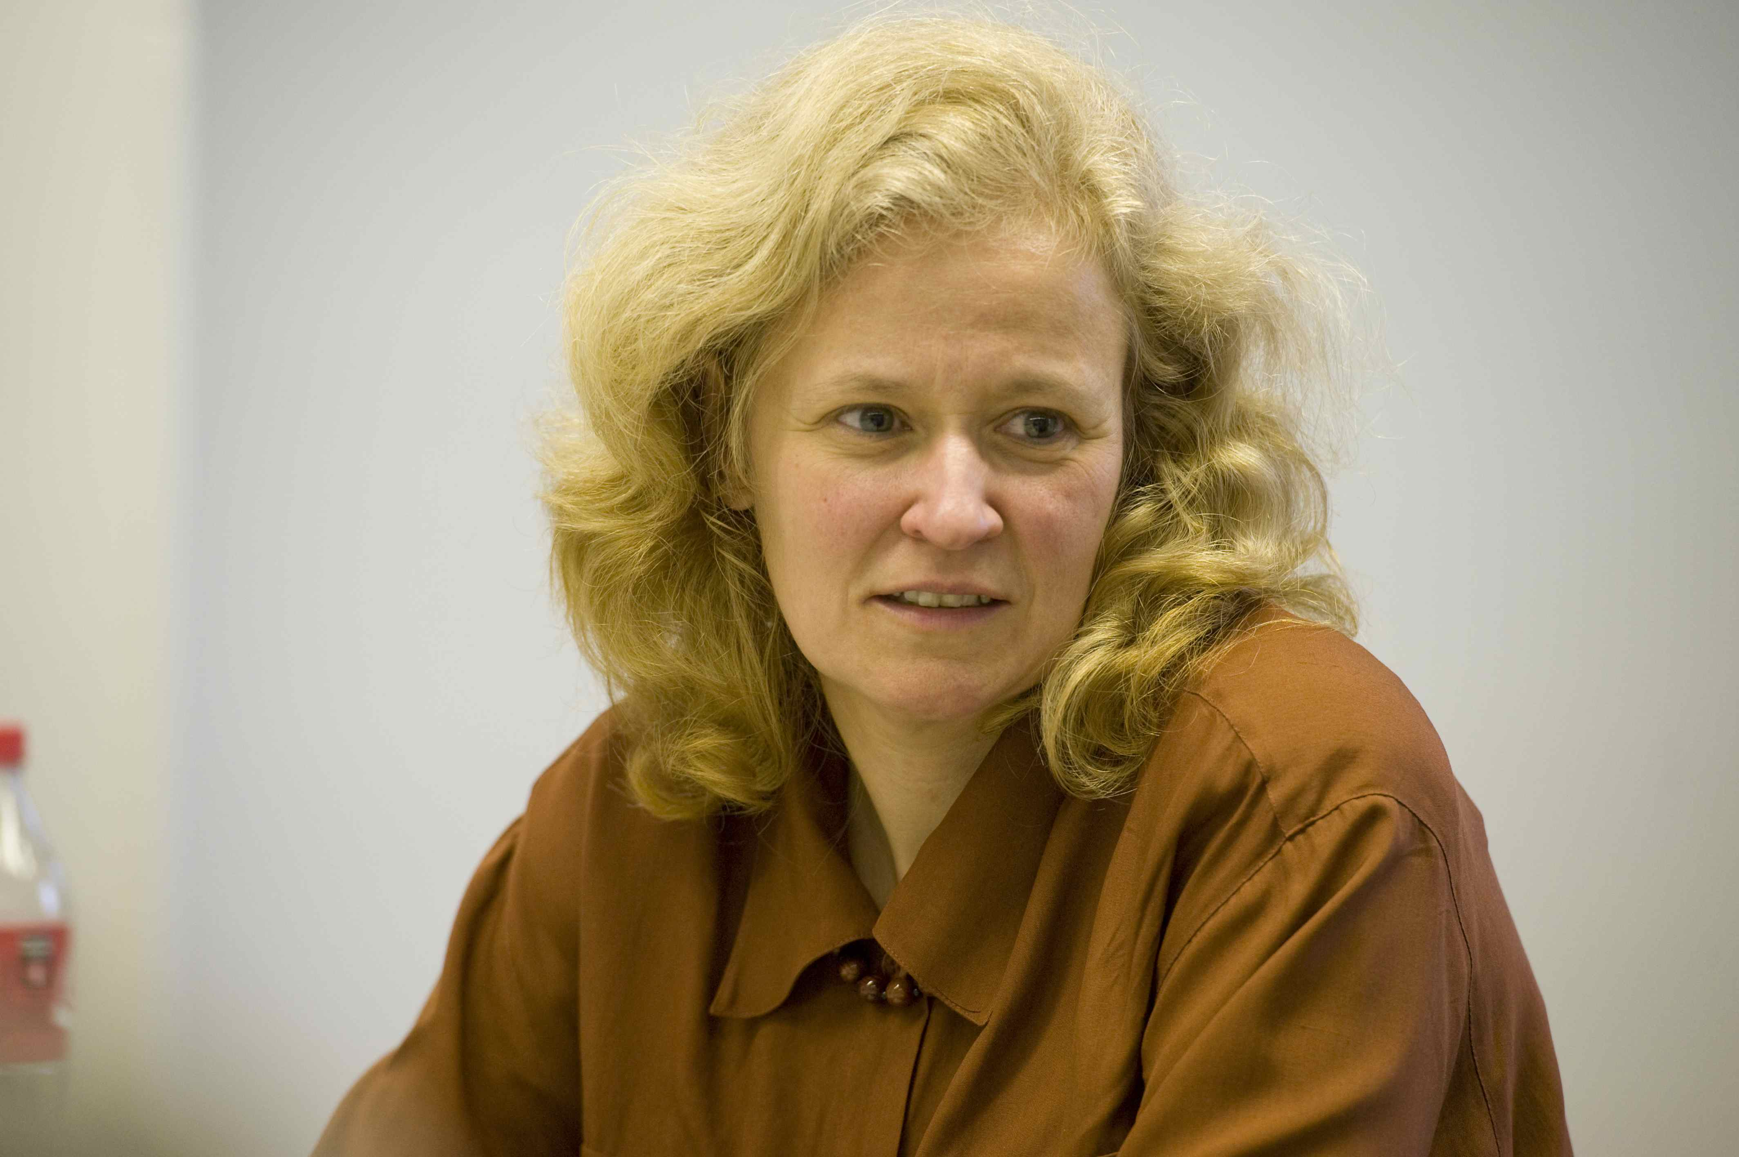
RU FAIR Professor in Camden
Georgia Arbuckle-Keil
Context
Predominantly undergraduate institution (PUI)
Few women faculty in natural sciences
Research and Programming Highlights
Networking
Time-management study
OASIS Professional & Leadership Development program
Peer mentoring
Exit interviews
Workshops on work-life balance and grantsmanship

Slide 89
RU FAIR Professor in New Brunswick
Context
largest faculty and student body
a decentralized campus (geographically and administratively)
Research and Programming Highlights
Leadership and Professional Development
Helen Buettner
Engineering as a Template
WiE Tenure & Promotion Workshop
Lunch Discussions with Dean Thomas Farris

Slide 90
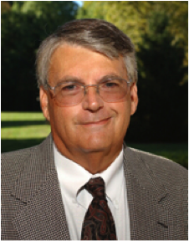
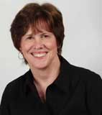
Pivotal Interactions in Leadership Development
Helen Buettner
RU FAIR Professor & Co-PI
2008
OASIS Pilot
HERS Bryn Mawr Summer Institute
Key Role Models
1999
Associate Dean
1995
Graduate Director
Brent
Ruben
ODL
Patricia Roos
FAS Dean’s Office

Slide 91
Initial Plan for New Brunswick
Women in Engineering (WiE)
Focus Group Feedback
Tenure & Promotion Workshop
Connections & Community
Leadership Development
Mentoring
Bring in guest lecturers

Slide 92
WiE Tenure & Promotion Workshop
Participants
6 panelists
5 professors attended
3 assistant
2 associate
Outcomes
Formal and informal communication of T&P rules
Forging of strong mentoring relationships
Networking among senior faculty and early-career colleagues
SoE Faculty

Slide 93
Lunch Discussions with SoE Dean Thomas Farris
Participants
Strengthening community of engineering women
Outcomes
5 women (Feb 2010)
Communicating information about RU FAIR ADVANCE programs and resources
Communication of Dean Farris’ commitment to diversity and excellence at SoE
13 women (May 2010)

Slide 94
Leadership Development: Myers-Briggs
(campus-wide workshop)
Facilitator: Dr Judith Katz, HERS Bryn Mawr Summer Institute
Recruitment through SciWomen listserv
Participants
28 women from 17 SEM Departments
Outcomes
Disagree Agree
1--------2-------3-------4-------5
Overall effectiveness of the program
95% found program useful and relevant
Notes:
DV: see glitches in formatting the pie chart

Slide 95
OASIS Spring 2011 Program
(campus-wide, early-career faculty)
Participants
Assistant and associate professors
Multiple disciplines
Topics
Leadership style
Negotiating
Work/life balance
Personal advocacy
Focus
Increased emphasis on research interests
Senior women to serve as mentors
Extend personal invitations

Slide 96
OASIS:
From Pilot to Signature Program
SciWomen OASIS (2008)
NB OASIS (2011)
RU FAIR OASIS
Camden OASIS (2010)
Merging of OASIS with RU FAIR Professorship Model

Slide 97
Grassroots… Regional Reach
Individual campus strengths/challenges drive the programmatic and research focus
Individual campus successes are spreading to university-wide application
Newark ‘Salary Study’
  Camden ‘Time Management Study’
  New Brunswick OASIS Program

Slide 98
Sustaining RU FAIR Professorships
Successes
Programs well received
Women engaged and feel supported
Challenges
Optimize impact to effort
Infrastructure support
Organic integration of approaches across campuses
Enhancing communication
and visibility
&

Slide 99
Sustaining RU FAIR ADVANCE
Successes
&
Challenges
Momentum in programs and research
Increasing core participation
Improving demographic indicators in most areas
Blending and integrating social science with natural science approaches
Developing solutions for a large, geographically and culturally complex campus
Impact of economic constraints

